Slide 1


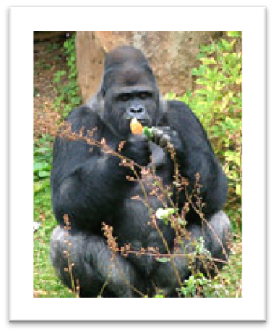
Subject: Weekly update
Dear Title First_Name Surname, (e.g. Thomas Smith)
Here is your weekly update from Claybrook Zoo. It covers important information about the opportunities you can take part in and other events taking place at the Claybrook Zoo.
KEY EVENTS
We have a Family day coming up on the 5th of February.
Exploration day on the 19th of February
Find out more
Meet our animal of the week
Redwell
Read more
To keep up to date with the latest information, please visit our website: www.Claybrook-Zoo.com
We look forward to welcoming you soon.
Kind regards,
Claybrook Zoo team
If you have any questions about the newsletter please don’t hesitate to contact us on newsletter@claybrookzoo.co.uk or Telephone Claybrook Zoo during our normal opening times 10-8pm
Terms and Conditions
Our Terms and Conditions apply to this newsletter.
This email has been sent to you by Claybrook Zoo.
You are receiving this email because you are currently subscribed to Claybrook Zoo Newsletter
Unsubscribe
Address
45 Zoo Lane , Eastlands, North Yorkshire, YR12 3TH, UK
www.Claybrook-Zoo.com

